Slide 1

EV Market Analysis
A comprehensive analysis of the global Electric Vehicle market using SQL, Python, and Power BI — uncovering insights into sales trends, pricing, battery performance, and customer preferences across 2,000 EV models.

Slide 2
Dataset at a Glance
2,000
24
Rows
Columns
EV models analyzed
Features per model
20
76
Brands
Models
Global manufacturers
Unique EV models
Car Specifications
Buying & Features
Range, Battery Capacity, Top Speed
Charging Speed, Horsepower, Torque
Acceleration, Weight
Brand, Model, Year, Variant, Price
Drive Type, Seating, Cargo, Safety
Autopilot Level, Country of Origin, Segment

Slide 3

Exploratory Data Analysis in Python
Data Loading
Imported dataset via pandas; used df.info() and .describe() for structure and summary stats.
Feature Engineering
Created sales_group (by total annual units sold) and performance_type (from acceleration) columns.
Database Integration
Connected Python to MySQL and loaded the cleaned DataFrame for SQL-based analysis.

Slide 4
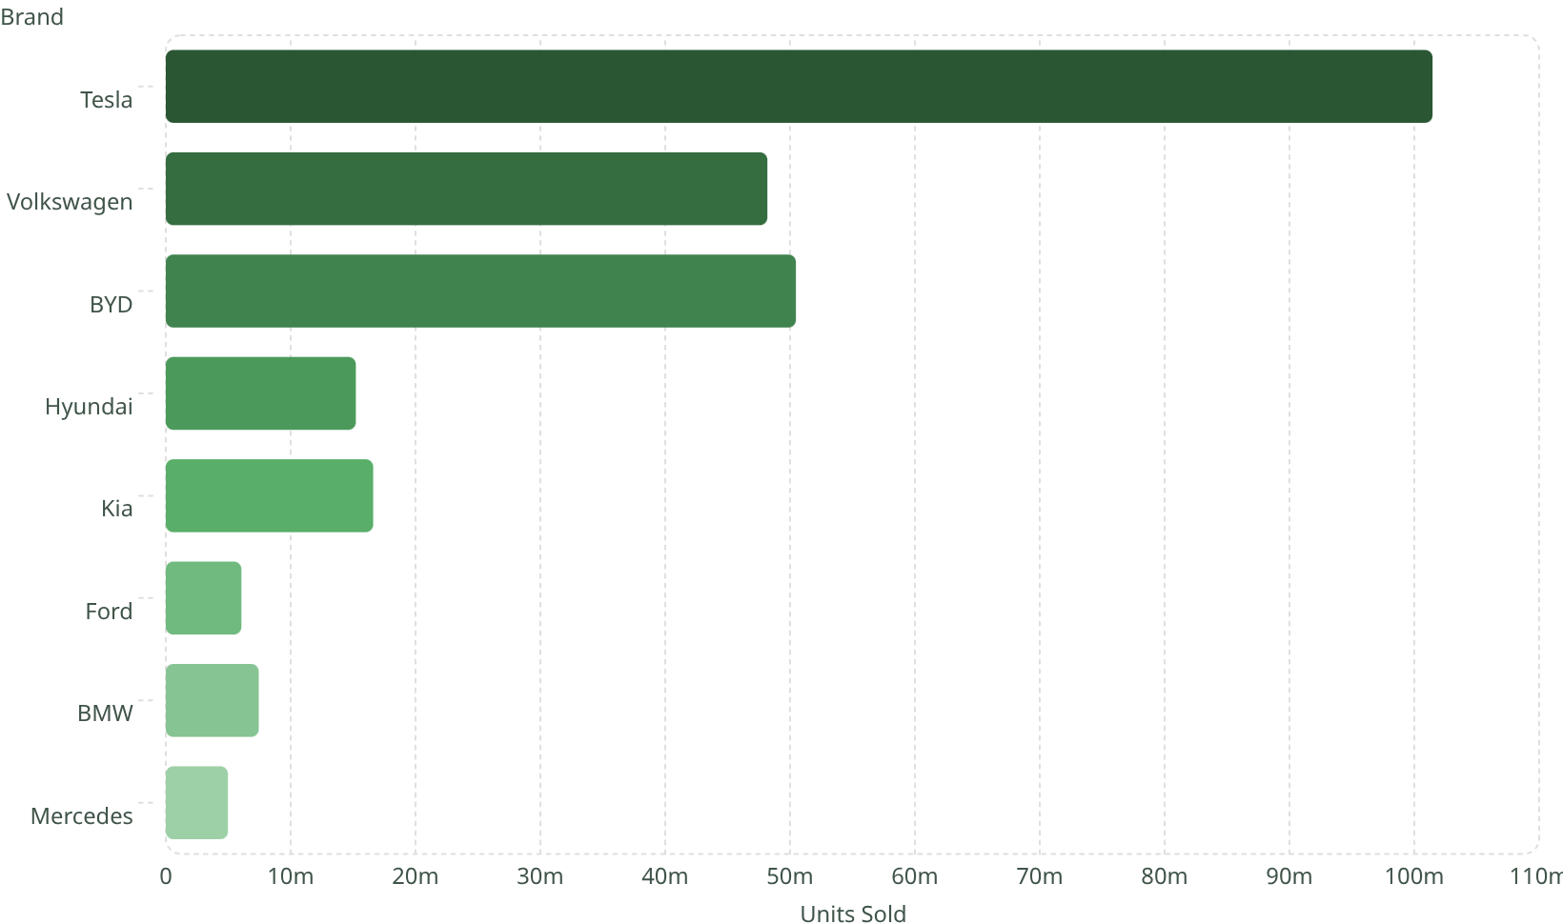
Units Sold by Brand
Key Findings
Tesla dominates with 101M+ units sold — nearly double BYD and Volkswagen.
Chinese brands (BYD) and Korean brands (Hyundai, Kia) represent strong competition in volume.
European luxury brands (BMW, Mercedes) hold a smaller but significant share.

Slide 5
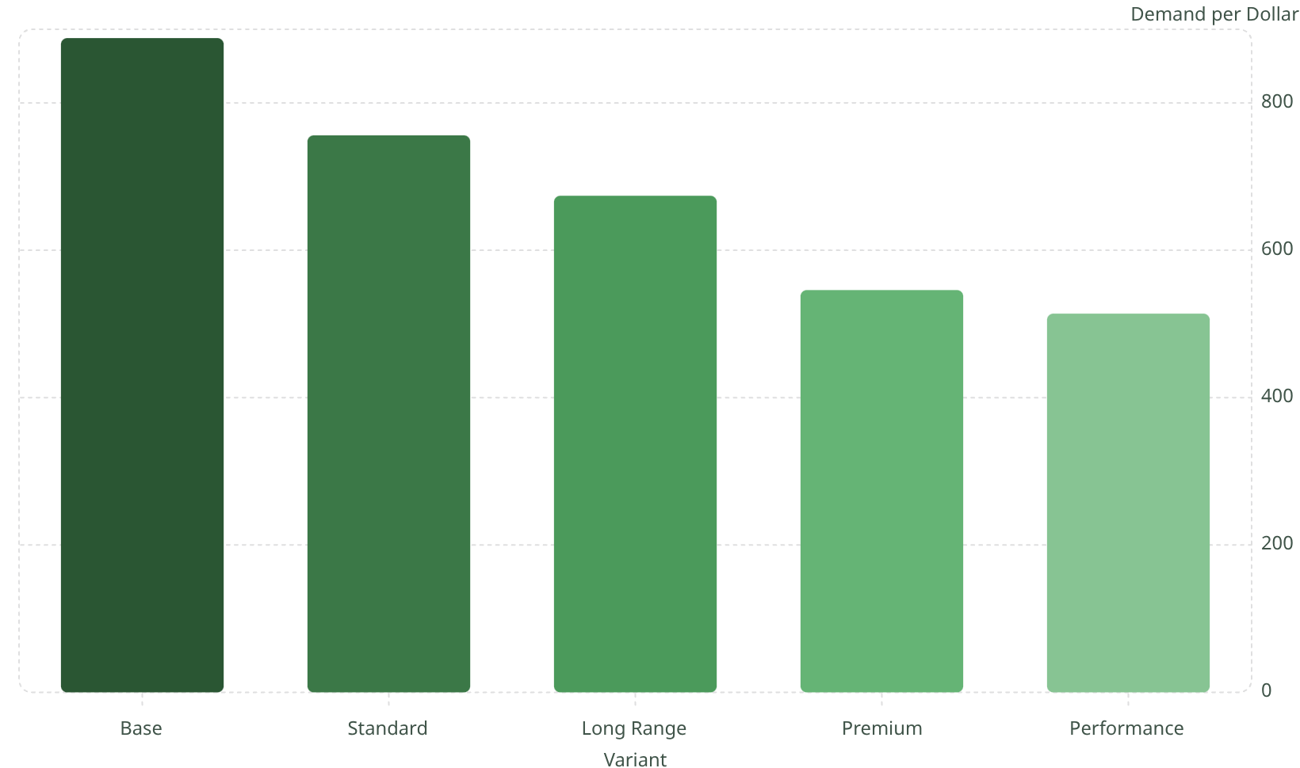
Variant Demand Per Dollar
Best Value Segment
The Base variant delivers the highest demand per dollar at 888.86, despite having the lowest average price ($61,567).
Higher-tier variants (Premium, Performance) generate substantial total sales but offer lower demand efficiency per dollar spent.

Slide 6
Top 5 Best-Selling Models
Model Y — Tesla
Model S — Tesla
Cybertruck — Tesla
490,678 units · Rating: 4.51
248,485 units · Rating: 4.42
187,262 units · Rating: 4.38
Model 3 — Tesla
GLE EV — Mercedes
136,524 units · Rating: 4.42
68,955 units · Rating: 4.39
Tesla occupies 4 of the top 5 spots, with the GLE EV as the only non-Tesla entry.

Slide 7
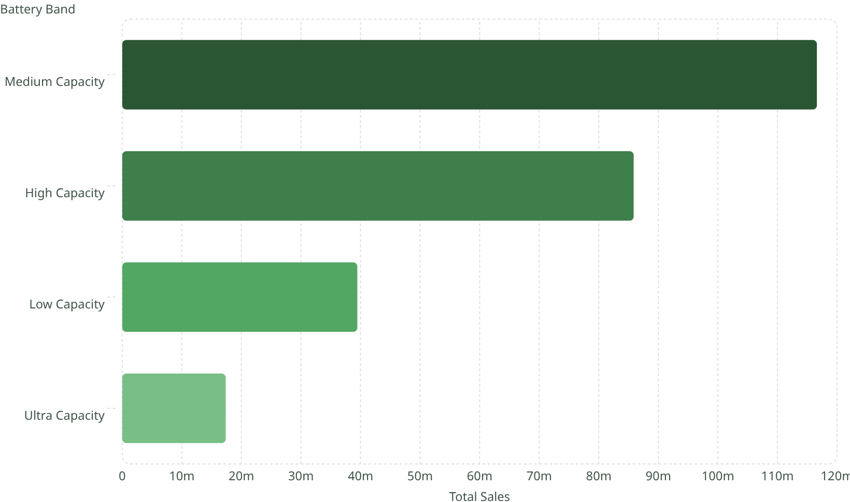
Battery Capacity & Country of Origin
Sales by Battery Band
Country of Origin — Avg Price vs. Range
US leads in total sales (110M units) with avg price $82,542 and range 259 mi.
Germany commands the highest avg price ($93,538) but lowest price-per-mile efficiency.
China offers the best price-per-mile ratio (239.07) with 51M units sold.

Slide 8
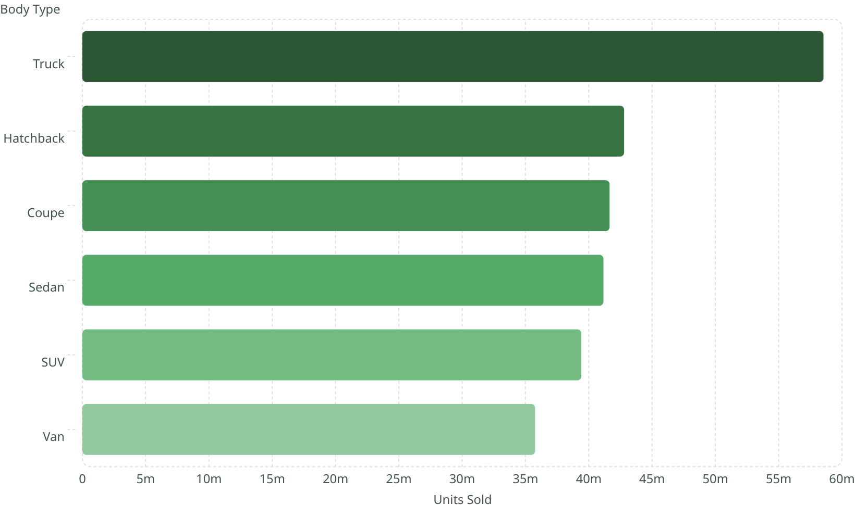
Body Type & Market Segment Sales
Segment Breakdown
Premium leads with 87M units, followed by Mid-range (83M) and Luxury (66M). Budget holds the smallest share at 23M.
Trucks dominate body types with 58.5M units — the strongest single category.

Slide 9
Power BI Dashboard — Key Metrics
259M
$78.9K
Total Units Sold
Avg EV Price
262
3.57
Avg Range (mi)
Avg Customer Rating
Top Companies by Sales
Models by Sales Category
Tesla — $9.43B
Volkswagen — $3.27B
BYD — $3.02B
Kia — $1.08B
Hyundai — $926B
Popular — 854 models
Unpopular — 549 models
Sold — 356 models
Best Seller — 93 models
Top Selling — 88 models

Slide 10


Business Recommendations
Prioritize Trucks, Hatchbacks & Sedans
These body types lead in unit sales — focus R&D and marketing investment accordingly.
Leverage US Market Strength
US-origin vehicles generate the highest sales volume (110M+ units) — deepen US brand presence.
Balance Base & Premium Variants
Base variants offer the best demand-per-dollar, but Premium variants drive higher total revenue — maintain both tiers.

